Slide 1
DQN and DDPG
Deep Learning and Practice 2019 spring
Department of Computer Science, NCTU
Author: Kuo Hao
Speaker: Kuo Hao

Slide 2
Outline
Deep Q-learning network (DQN)
Experience replay
Target network
Deep Deterministic Policy Gradient (DDPG)
Appendix
Double DQN
Prioritized experience replay

Slide 3
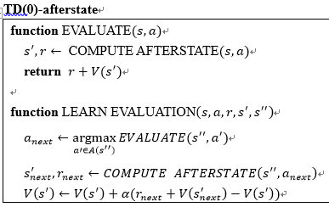
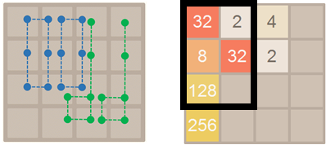

Q-learning
Q-learning: (from 2048): Use n-tuple network: manual feature pattern

Slide 4
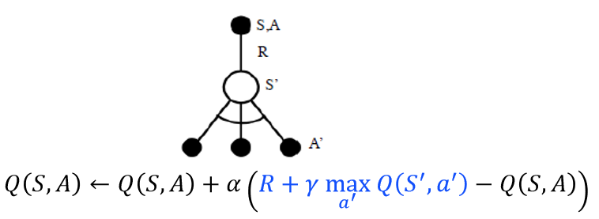
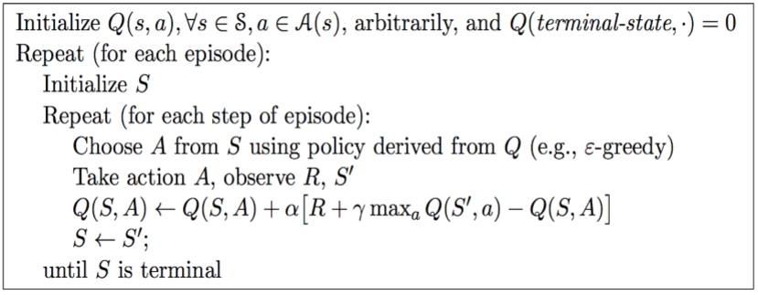

Slide 5
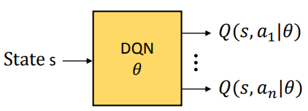
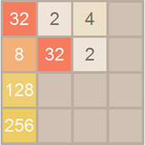

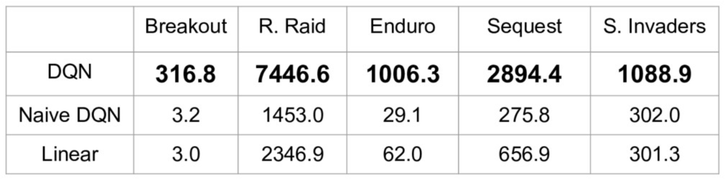
Deep Q-learning Network
Can we use neural network Q function? YES
V(s) or Q(s, a)

Slide 6
Deep Q-learning Network
Input: State (𝑠_{𝑡})
Raw image, internal state information
Not necessary to use manual feature pattern
Output: Action value function
Action Value: 𝑄(𝑠_{𝑡} , 𝑎_{𝑡} |𝜃)
Select action: arg max 𝑄(𝑠_{𝑡} , 𝑎′|𝜃)
Target Q: Y_{t}^{Q} = r_{t+1}+ γ * max 𝑄(𝑠_{𝑡+1} , 𝑎′|𝜃)
Loss: (Y_{t}^{Q} - 𝑄(𝑠_{𝑡} , 𝑎_{𝑡} |𝜃) )²
Network:
Input → (CNN/RNN) → fully connected layer * n → output

Slide 7
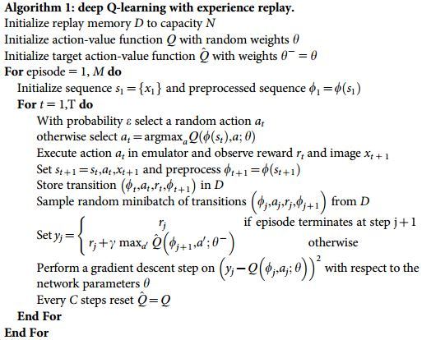
Deep Q-learning Network
Q-learning
2 mainly techniques:
Experience Replay
Target Network

Slide 8



Experience replay
TD target
TD error
Work process:
Store every transition (s, a, r, s’) into replay buffer
Random sample minibatch of transitions for update network
Update agent’s network with minibatch
Replay buffer
Minibatch
S₁, A₁, R₁, S₂
S₂, A₂, R₂, S₃
S₃, A₃, R₃, S₄
...
S_{t}, A_{t}, R_{t}, S_{t+1}
Sample transitions randomly
S₂, A₂, R₂, S₃
S₆, A₆, R₆, S₇
...
S_{n}, A_{n}, R_{n}, S_{n+1}
Save each transition (S, A, R, S’)

Slide 9
Experience replay
Feature:
Break correlation between experiences in update network
Previous: update network with whole path → Need good path (hard)
Now: update network with transitions → Only need good transition (easy)
Increase learning speed with minibatch
Reuse transitions to avoid forgetting
Learning = fitting the training data
Replay buffer
S₁, A₁, R₁, S₂
S₂, A₂, R₂, S₃
S₃, A₃, R₃, S₄
...
S_{t}, A_{t}, R_{t}, S_{t+1}

Slide 10
Target network
Unstable target function makes training difficult
Due to update with minibatch
In TD error calculation, target function is changed frequently with DNN
E.g.: (extreme case)
Replay buffer
Sample one transitions
Update network
S₁, A₁, R₁, S₂
S₂, A₂, R₂, S₃
S₃, A₃, R₃, S₄
...
S_{t}, A_{t}, R_{t}, S_{t+1}
S₂, A₂, R₂, S₃
Can’t use the replay buffer data Q(s, a) is changed!! (to Q’(s, a)) Replay buffer data is for Q(s, a)

Slide 11

Target network
In TD error calculation, target function is changed frequently with DNN
 | 左 | 右
Q | 1 | 1
 | 左 | 右
Q | 2 | 1
Once network update, the value function is different!! Q(s, a) is changed!! (to Q’(s, a)) Replay buffer data is for Q(s, a)
Replay buffer
TD target
S₁, A₁, R₁, S₂
S₂, A₂, R₂, S₃
S₃, A₃, R₃, S₄
...
S_{t}, A_{t}, R_{t}, S_{t+1}
TD target
So need to fixed the value function Q(s, a) → Use two network

Slide 12
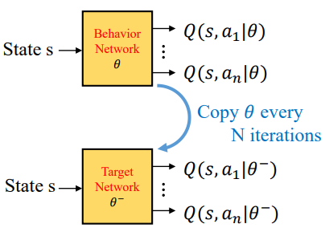

Target network
Solution: Use 2 network
Target network & Behavior network
Target network
Fix parameters of target function
Replaces target function with the latest network every N-steps
Behavior network
Keep updating by target network’s function
TD target
TD error

Slide 13
Behavior network
Target network
Start to play
Epsilon greedy policy
Store each transition in replay buffer
Random sample
Update behavior network with target network’s value function
Sync target network

Slide 14
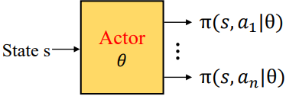
Value base v.s. Policy base
Value base:
Output: Value function
Select action: Choose action max(Q(s,a))
Must in discrete action space
Look up table
Policy base:
Output: Distribution of the action
Use policy gradient to update network
Select action: Choose action with max probability / sample from distribution
Continuous space also works!!
Intuitive response

Slide 15
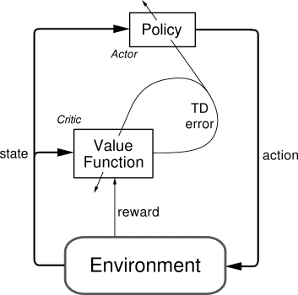
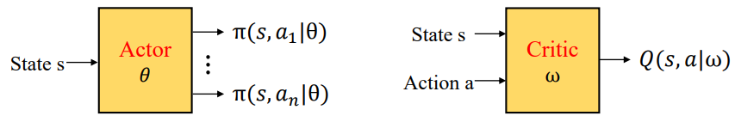
DDPG
From DQN & Double DQN research:
Behavior network: Decide action
Target network: Provide value function
It’s value base model
Actor-Critic architecture:
Actor: Decide action
Critic: Value function to judge the action
Combine policy base and value base model

Slide 16
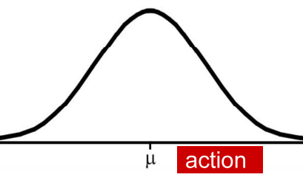
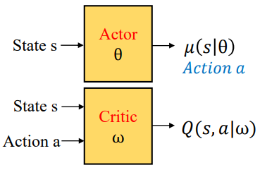
DDPG
Deep Deterministic Policy Gradient
Deterministic: Use sample as the selected action
Critic: Provide value function (Q) for actor
Actor: Update policy in direction that improves Q

Slide 17
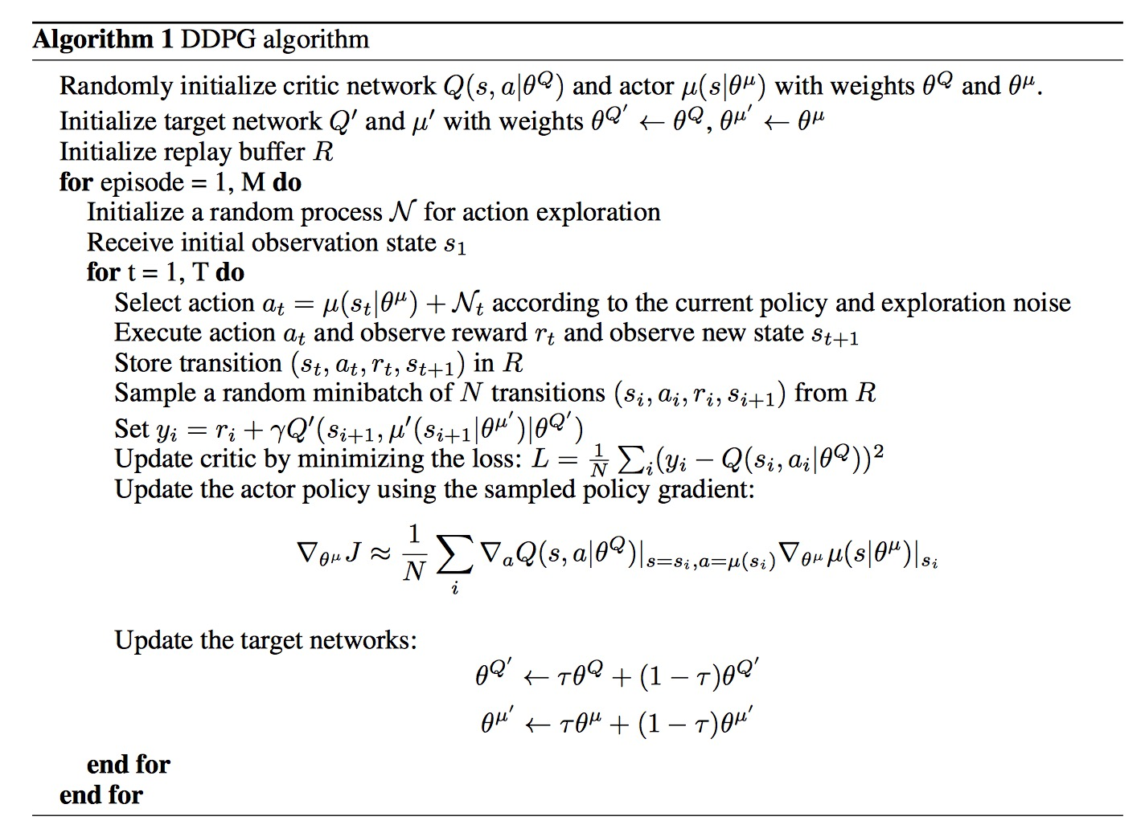
Use 2 network for critic & actor Critic/Critic target
Actor/Actor target
Select action with distribution (actor’s policy)
Store each transition in replay buffer Random sample for update
Update critic with 1. Action from actor target 2. Value from critic target
Update actor distribution to max critic value (policy gradient)
Soft update

Slide 18
Appendix
Double DQN
Prioritied experience replay

Slide 19
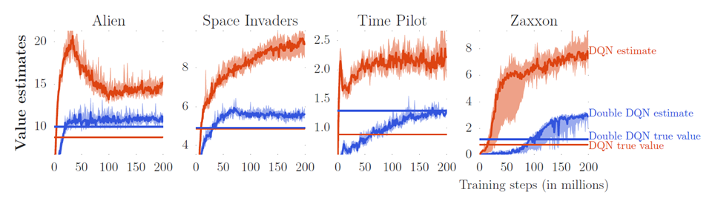
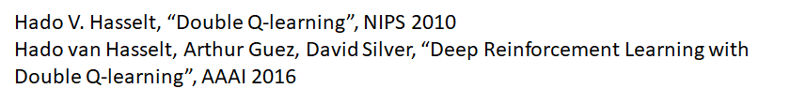
Double DQN
TD target
Q value is usually over-estimated

Slide 20
Double DQN
Q value is usually over-estimated:
Tend to select the action that is over-estimated
Reason: Use same network to decide action and judge the value function
select “左” to update
左 | 右
1 | 1
左 | 右
2 | 1
...
always select “左” to update
TD target

Slide 21
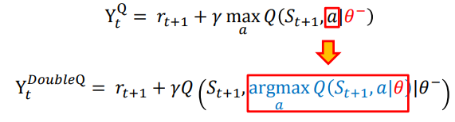
Double DQN
TD target:
Split the choose action part and value function:
Behavior network (BN) decide action
Target network (TN) provide value function
If BN over-estimate an action, so it is selected. TN would give it proper value
If TN over-estimate an action, this action will not be selected by BN

Slide 22
Double DQN
TD target
BN over-estimated
TN over-estimated
 | 左 | 右
Q | 2 | 1
 | 左 | 右
Q | 2 | 1
BN
Propose “左”
Propose “左”
Not choose “右”
TN
 | 左 | 右
Q | 1 | 1
 | 左 | 右
Q | 1 | 5
 | 左 | 右
Q | 2 | 1
Fix by sync with BN every N-steps
TN give proper value =1
TN give proper value =1

Slide 23
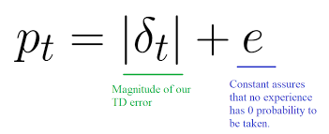
Prioritied experience replay
Random sample transitions is not efficient enough
Should focus on those transitions that help updating network
Helpful transitions
Large loss will significantly update network model
Not guarantee for better network model
But value function will filter those bad tranisition (by select action to max Q)
Process (every K-steps):
Sample the transitions with priority distribution
Calculate loss (TD error) for each transition in replay buffer
Assign the priority of each transition according to loss
Update network

Slide 24
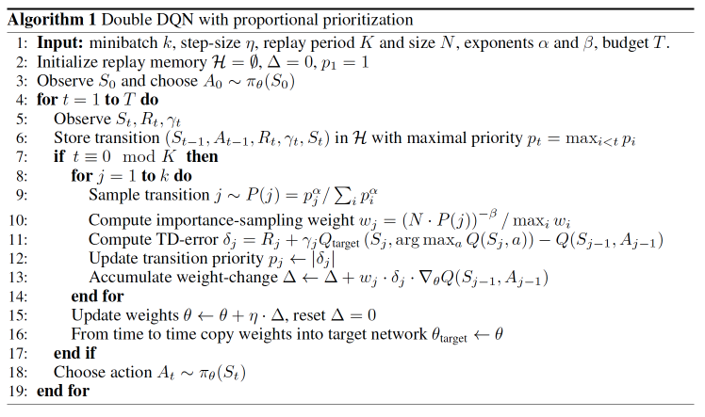
Prioritied experience replay

